Slide 1
Artificial Intelligence Workshop Summer School 2023 Dr. Vinod PANGRACIOUS

Slide 2
What is Artificial Intelligence

Slide 3
It is the science and engineering of making intelligent machines, especially intelligent computer programs.

Slide 4
What is intelligence ?

Slide 5
Intelligence is the computational part of the ability to achieve goals in the world. Varying kinds and degrees of intelligence occur in people, many animals and some machines

Slide 6
Intelligence involves mechanisms, and AI research has discovered how to make computers carry out some of them and not others. If doing a task requires only mechanisms that are well understood today, computer programs can give very impressive performances on these tasks. Such programs should be considered “somewhat intelligent”.

Slide 7
Deep Learning Basics

Slide 8
AI vs ML vs DL
Artificial Intelligence (AI) is a field of science that deals with the development of algorithms that allow computers to learn without being explicitly programmed.
Machine Learning (ML) is a sub-field of AI. ML focuses on the methods that learn from data and make predictions on unseen data.
Deep Learning (DL) is also a sub-field of ML that deals with the development of neural networks.
Neural networks are capable of discovering complex relationships in data without being told about them explicitly.
Deep Larning deals effectively with data in the form of images and videos.

Slide 9
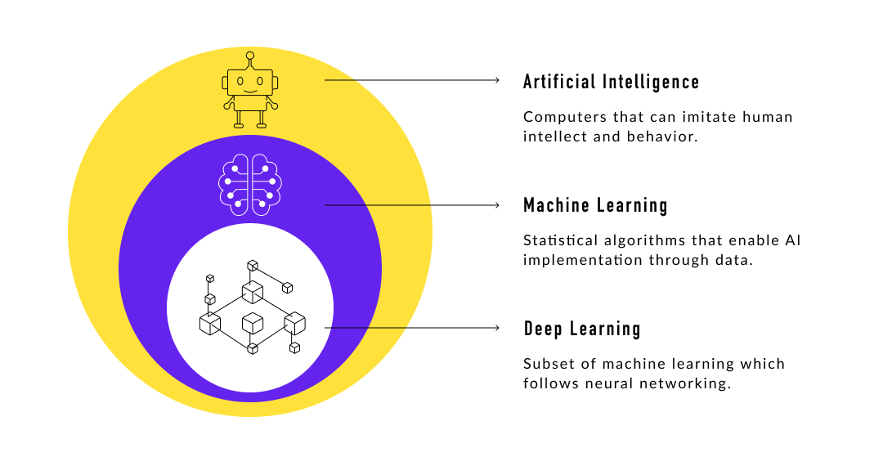

Slide 10



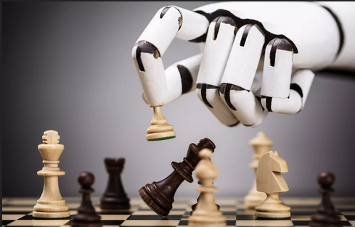
Applications of AI
Stock Prediction
Game Playing
Spam Filters
Chatbots

Slide 11
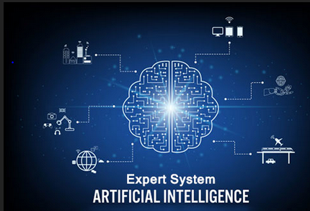

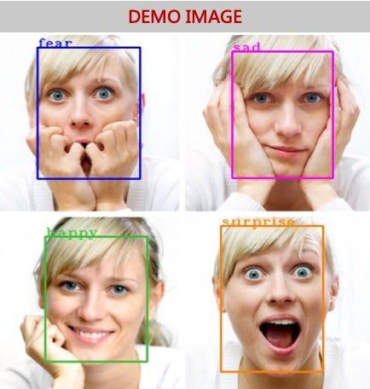
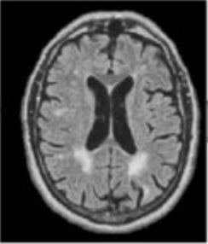
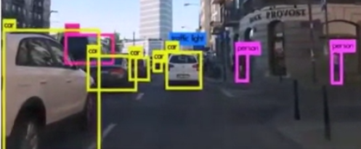
Applications of DL
Expert Systems: Robotics, Medical Diagnosis,
Disease Prediction
Emotion Detection
Automated or Autonomous Driving

Slide 12
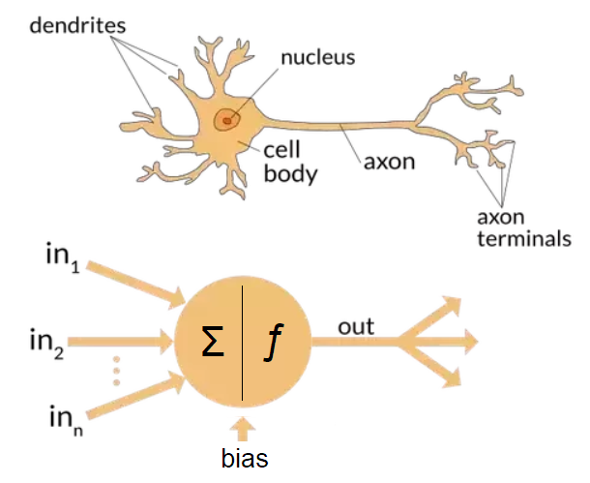
Neural Networks
Neural Networks are DL structures that are meant to imitate the nervous system of humans.
Our nervous system helps us perceive the outside world.
Neural networks allow computers to make sense of data.
Each cell in our nervous system is a neuron.
In neural networks, each node is called a perceptron.

Slide 13
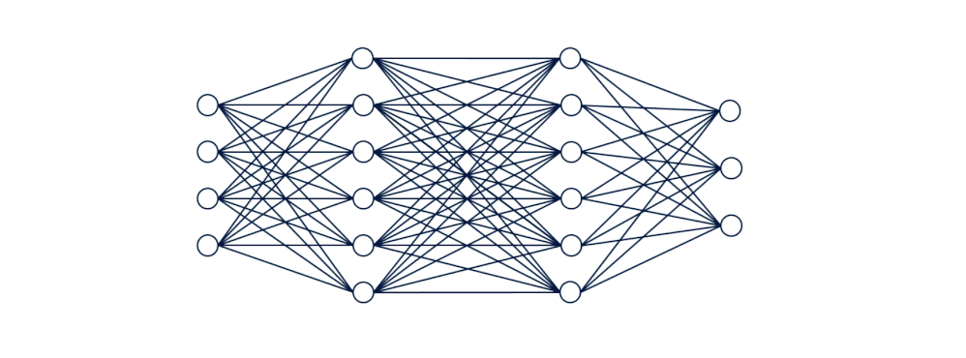
Neural Network Process
Initialize weights and biases
Forward Propagation
Compute loss function
Back Propagation
Steps 2-4 are repeated for
n-iterations till we get the
minimized loss.
Image link : http://bit.ly/2Dcvw7M

Slide 14
Weights and Activation Function
Each perceptron produces an output based on simple internal computations.
The input values to a neuron are multiplied by the weights.
A higher weight signifies a greater importance of the data.
The weights are recalculated after each training run.
An activation function determines whether to “fire”, or activate, a perceptron.
The higher the internal computation of a neuron, the more likely it is activated.
The activation function of a neuron is pre-determined and fixed.
Networks of connected perceptrons in layers can make complex computations such as face recognition

Slide 15
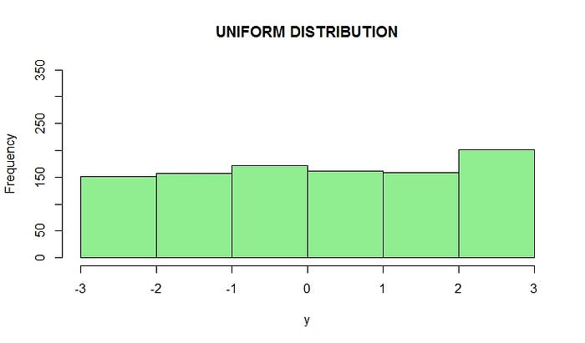
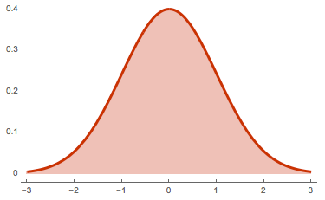
Weight Initialization What makes a good or bad initialization? How can different magnitudes of initializations lead to exploding and vanishing gradients?
Building a neural network is a tedious task and upon that training it to get better results is more challenging.
The first challenging task that comes into consideration while building a neural network is initialization of weights,
if the weights are initialized correctly, then optimization will be achieved in the least time, Otherwise converging to minima is impossible.
We used two methods for weight initialization
Uniform distribution
Normal distribution

Slide 16
If we initialize weights to all zeros or the same value, what problem arises?
Weights initialized to “0” will force al neuron layers provide same output and the derivative with respect to loss function is the same for every weight.
The model will not learn anything, the weights will not be updated and we face a vanishing gradient problem
Random Initialization of Weights
Will lead to vanishing gradient problem if the values initialized is very low and exploding gradient if the values initialized is very high.

Slide 17
Weight Initialization
Xavier Glorot Initialization of Weights
Random uniform distribution draw each weight, w, from a random uniform distribution in [-x,x] for x = Sqrt(6)/Sqrt(inputs + outputs)
Normal Distribution draw each weight, w, from a normal distribution with mean of 0, and a standard deviation σ = Sqrt(2)/Sqrt(inputs +outputs)
The weights set the by Xavier Glorot Initialization are not big nor too small. Hence we won’t face the problem of vanishing gradients or exploding gradients
Xavier Glorot Initialization helps in faster convergence to minima.

Slide 18
He or Hey Initialization of Weights
He-Uniform initialization of weights: draw each weight, w, from a uniform distribution in in [-x,x] for x = √6/ √ (inputs)
He-Normal initialization of weights: draw each weight, w, from a normal distribution with mean of 0, and a standard deviation σ=√2/ √(inputs)
In He- initialization, we set weights neither too big nor too small. Hence, we won’t face the problem of vanishing gradients and exploding gradients. Also, this initialization helps in faster convergence to minima.

Slide 19
How to choose the right weight initialization
As there is no strong theory for choosing right weight initialization, we just have some rule of thumb methods i.e.,
When we have a sigmoid activation function, it is better to use Xavier Glorot initialization of weights.
When we have ReLU activation function, it is better to use He-initialization of weights.
Mostly, Convolutional neural network will use ReLU activation function and it use’s he-initialization.

Slide 20
Why we need Activation Function
When we feed lots of information to our brain, it tries hard to understand and classify the information between useful and not so useful information.
In the same way, we need similar mechanism to classify the incoming information as useful and not useful in case of neural networks. Only some part of information is much useful and rest may be some noise.
Activation function helps network to learn useful information
The Activation function tries to build the wall between useful and less useful information

Slide 21
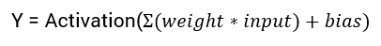
What is an Activation Function
“ An activation function is a non-linear function applied by the neuron to introduce non-linear properties in the network.”
in the simple case of any neural network, we multiply weights with the input, add bias and apply an activation function and pass the output to the next layer and we do backpropagation to update the weights.
Neural networks are function approximators.
The main goal of any neural network is to learn complex non-linear functions.

Slide 22

Common Activation Functions

Slide 23
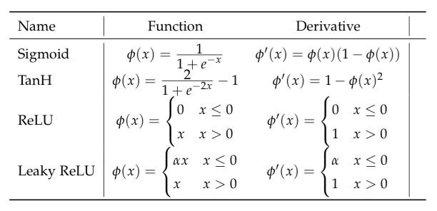
Common Activation Functions

Slide 24
How to choose the right activation function?
Depending upon the properties of the given problem, we might be able to make a choice and can make a faster convergence of the network.
Sigmoid functions work better in case of classifiers.
ReLU is a general activation function and can be used in most cases.
If we encounter dead neurons in our network, then Leaky ReLU is the best choice
As a rule of thumb, we can begin with ReLU activation function and we can move to other activation functions if ReLU does not perform well in our network.

Slide 25
Types of Neural Networks
There are three main types of Neural Networks
Convolutional Neural Networks
Feed-forward Neural Networks
Recurrent Neural Networks
The focus of this talk is on Convolutional Neural Networks (CNNs). We will briefly look into feed-forward and recurrent neural networks.

Slide 26
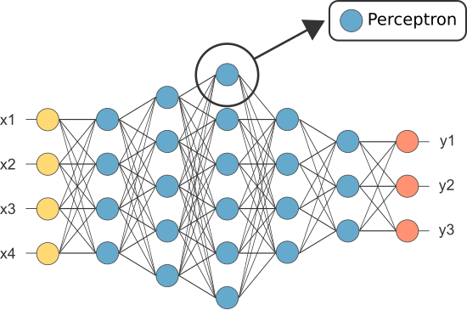
Feed-Forward Neural Networks
In a feed-forward neural network, there are multiple perceptron layers
Each perceptron in one layer is connected to each and every perceptron in the previous and immediately next layer
However, no perceptron in the same layer are connected.
Information is constantly fed forward from one layer to the next.

Slide 27
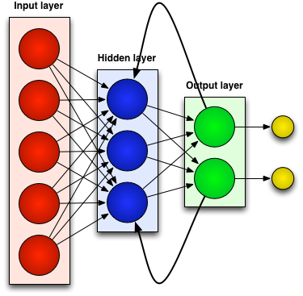
Recurrent Neural Networks (RNN)
Recurrent neural networks can process time series data
Recurrent neural networks hold the “memory” from their past to make judgements about the future
Unlike other neural networks, recurrent neural networks can take inputs of variable sizes
Google Neural Machine Translation system (GNMT)
These networks are at the heart of speech recognition, translation

Slide 28
Convolutional Neural Networks
(CNNs)

Slide 29
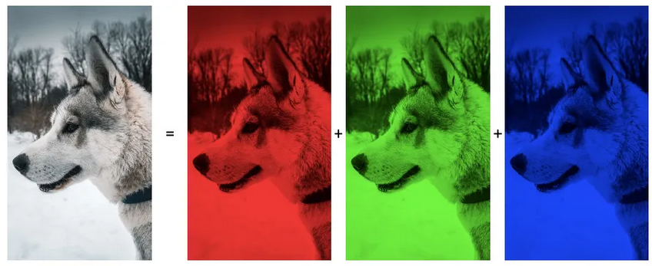
Convolutional Neural Networks
CNNs are one of the most common type of neural networks. They assume that their inputs are images and optimize the network to work with images.
CNNs have 3 dimensions, width, height, and depth.
The depth of a CNN refers to the number of color channels it has. For example, a typical color image has 3 channels: Red, Green, and Blue (RGB).

Slide 30
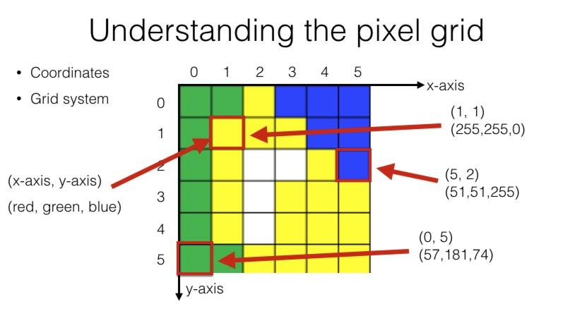
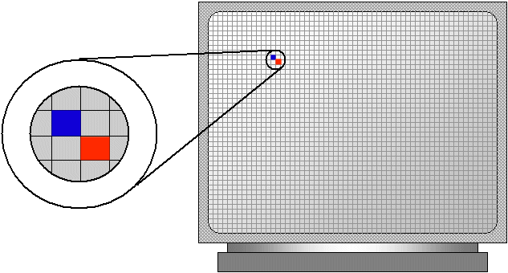
Image as Matrix of Pixels
Pixel: smallest
element of image
Pixel represented by 3 numbers: Red, Green and Blue.

Slide 31
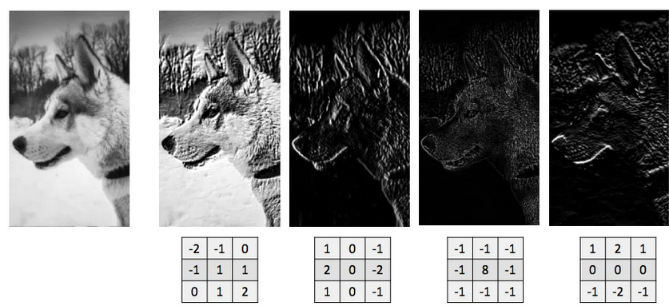
Convolutional Neural Networks
Each perceptron in a CNN is connected to a small portion of perceptrons in the layers before and after it rather than being fully-connected.
Three types of layers are used to build CNNs: Convolutional Layer, Pooling Layer, and Fully-Connected Layer.
Convolution layer extracts key features of image through filters.

Slide 32
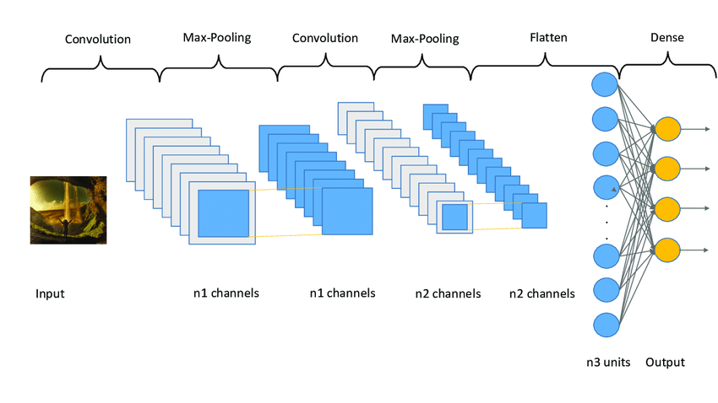
First point
Structure of CNN

Slide 33
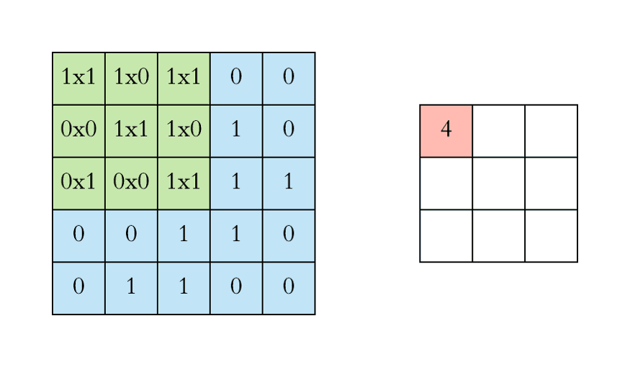
Convolution Layer
The convolutional layer is the building block of all CNNs
The convolution is used to extract meaningful features from images
A kernel, or filter, slides over the input image and performs a mathematical operation. The output of the convolution is a set of represent specific patterns in the input data
After each convolution operation, a CNN applies a Rectified Linear Unit (ReLU) transformation to the feature map, introducing nonlinearity to the model.

Slide 34
Pooling Layer
Pooling is used to reduce the size and complexity of the feature maps produced by the convolutional layers
During pooling, a small window or region slides over the feature map, typically taking the maximum value (max pooling) or the average value (average pooling) within that window
The output of the pooling layer is a downsampled version of the feature map, retaining the most important information while reducing the spatial dimensions

Slide 35
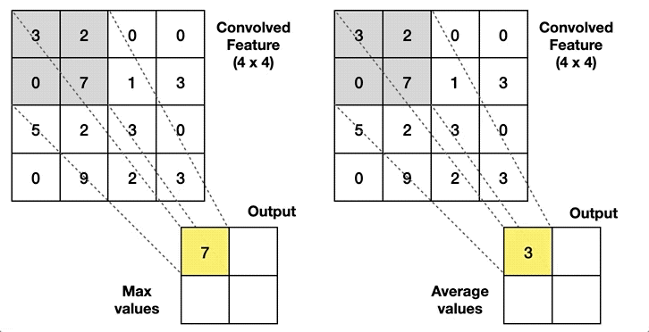
Max pooling: As the filter moves across the input, it selects the pixel with the maximum value to send to the output array.
Average pooling: As the filter moves across the input, it calculates the average value within the receptive field to send to the output array.
Max Pooling
Average Pooling
Pooling help to reduce complexity, improve efficiency, and limit risk of overfitting

Slide 36
Fully-Connected Layer
A fully-connected layer is a fundamental component of a neural network, often used after convolutional and pooling layers
In a fully-connected layer, every neuron is connected to every neuron in the previous layer
Each connection is associated with a weight, and the output of a neuron is determined by combining the weighted inputs using an activation function
The fully-connected layer takes the high-level features extracted by previous layers and transforms them into predictions
FC layers usually leverage a softmax activation function to classify inputs appropriately, producing a probability from 0 to 1

Slide 37
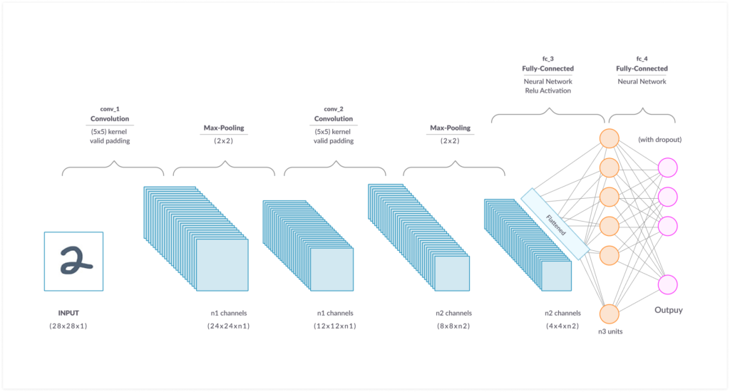
Fully-connected layers

Slide 38
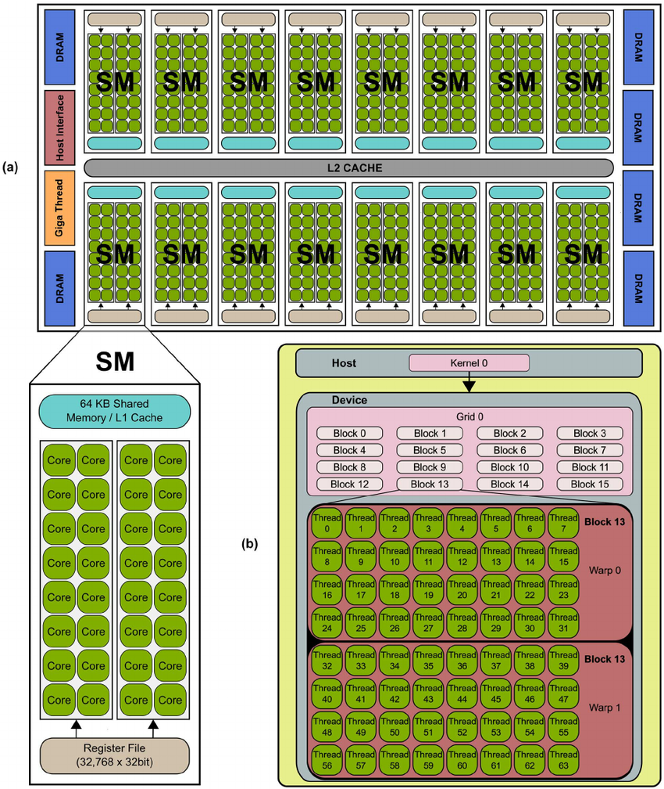
Advances in Computing Hardware
Graphical Processing Unit (GPU)
CNN has large number of parameters (millions).
NVIDIA (or other) GPU make DL with CNN possible.
Stream Multiprocessors (SMs) or Shaders
(total 16*32 =512 cores).

Slide 39
Deep Learning Workflow

Slide 40
Deep Learning Workflow
Working a deep learning model is divided into four key components
Model design and construction
Model Training
Model Testing
Model Deployment

Slide 41
Training
DL model “learns” during training process.
Model is trained on training dataset, a subset of entire dataset.
Training dataset is divided in batches.
Passed through model multiple epochs (multiple times).
Weights of model are adjusted during training:
Ensure model’s predicted output are as close to actual output as possible.

Slide 42
Testing
Evaluation of model’s accuracy.
Testing dataset, a subset of the entire dataset, used for testing the model.
Testing dataset is completely separate from the training dataset and is usually significantly smaller in size.
Model with high testing accuracy can be used in real world.
Model with low testing accuracy might need to be trained again.

Slide 43
Deployment
Once a model has performed well in the testing phase, it may be deployed.
Some models may be used in real-world projects such as face detection at airports or automated driving.
If the models were built for the purpose of research, they might be published about.

Slide 44
Understanding Deep Learning Terminology

Slide 45
Epoch
An epoch represents a complete run through all the examples in the dataset, where the network processes each example and adjusts its internal parameters (weights and biases)
In one epoch, the network goes through all the examples, makes predictions, calculates the errors, and updates its parameters to improve its performance
The number of epochs is a hyperparameter set by the user, determining how many times the network will iterate over the entire dataset
Usually, an increase in epochs, increases the accuracy of the model

Slide 46
Batch Size
It is often more efficient to process data in small groups rather than individually
Batch size determines the number of examples that are grouped together and fed into the network at once before the model updates itself
A smaller batch size means the network is updated more frequently, but it increases the computational time
Conversely, a larger batch size reduces the frequency of updates but increases the computational resources used

Slide 47
Learning Rate
The learning rate controls how much these parameters are updated in response to the calculated error. It determines the size of the "step" taken towards finding the optimal solution
A higher learning rate means larger steps, which can lead to faster convergence but may result in overshooting the optimal solution or bouncing around it
Conversely, a lower learning rate means smaller steps, which can lead to more precise adjustments but may require longer training time

Slide 48
Loss Function
The loss function calculates this error by taking the predicted outputs and the corresponding true outputs as inputs
The output of the loss function represents a single value that measures the dissimilarity between the predicted and true outputs
The choice of a specific loss function depends on the type of problem being addressed, such as regression or classification, and the desired properties of the model

Slide 49
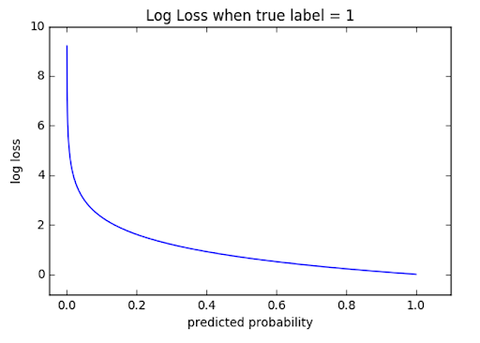
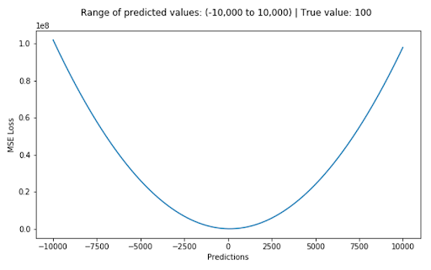
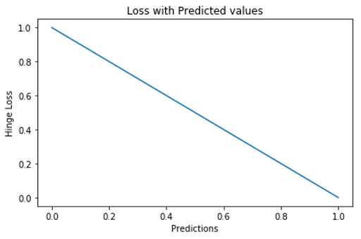
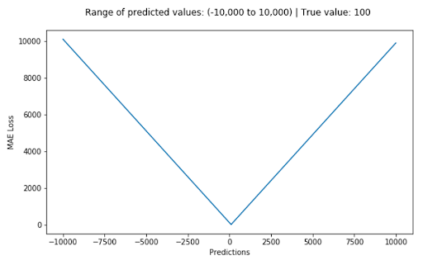
Examples of Loss Functions
⇐Log Loss
⇐L2 Loss
Hinge Loss⇒
L1 Loss⇒

Slide 50
Overfitting

Slide 51
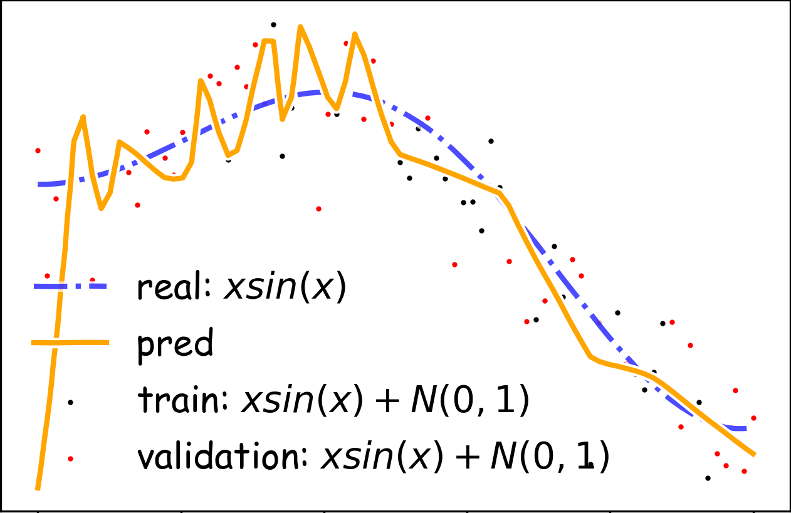
Overfitting
When training neural networks, the aim is to ensure that the network’s prediction is as close to the actual value as possible
However, sometimes the network “learns” more than necessary and starts to memorize examples
The network is not able to produce generalizable results
The network performs exceptionally well on data it has viewed, but underperforms on new data

Slide 52
Solutions to overfitting
Regularization helps counter overfitting. Regularization is an umbrella terms for techniques that are used to prevent overfitting.
A few regularization techniques include:
Data augmentation
Dropout
Norm Penalties
Early Stopping

